Slide 1
Welcome
Project'Or RIA is a Project Organizer Rich Internet Application.
Project'Or RIA focuses on IT Projects, but is also compatible with all kinds of Projects.
Its purpose is to propose a unique tool to gather all the information about the projects.
The fact is that many Project Management softwares just focus on planning. But it is a much too restrictive point of view. Of course planning is an important activity of Project Management and is one of the keys to Project success, but it is not the only one.
Project Managers need to foresee all what can happen, measure risks, build action plan and mitigation plan.
It is also important to track and keep traces of all what is happening to the Project : incidents, bugs , change requests, support requests, ...
In this objective, Project'Or RIA gives visibility at all levels of Project Management.
At lower level, the Project follow-up consists in gathering all information, and maintain it up to date. This involves all the operational team.
At upper level, Project Steering uses the follow-up data to take the decisions and build the action plan. This allows to bring the adjustments needed to target on the objectives of the project.
The goal of Project'Or RIA is to be Project Management Method independent. Whatever your choice on the method, you can use Project'Or RIA.

Slide 2
Functional (1/3)
Work
Tickets follow-up, for short activity follow-up such as support or bug fixing.
Activities follow-up, for work needing to be planned such as development or evolution.
Milestones follow-up, to define key dates of the planning.
Hierarchic level management via links of Activities, Tickets or Milestones to parent Activity.
Dependencies management between Activities, Milestones and Projects for accurate planning.
Assignment of resources to activities.
Workload management.
Cost management.
Workflow definition for status change.
Follow-up
Planning functionality, in a simple and understandable way, taking into account resource capacity, resource affectation rate to project and resource assignment rate to activity.
Planning presentation for projects, activities, milestones and dependencies in a Gantt view.
Workload follow-up for resources.
Printable reports, with graphics and possibility to export to PDF format.

Slide 3
Functional (2/3)
Risk Management Plan
Risk follow-up, with complete description of risks and criticality enlightening.
Action follow-up, with complete description, status and accountable assignment.
Issue follow-up, to track Project issues when risks occur.
Links management, between Actions, Issues and Risks.
Review logs
Meetings follow-up, with summary of status and minutes.
Decisions follow-up, with full description and origin reminder.
Questions management, to track exchanges and responses.
Links management, between Meetings and Decisions and Questions.
Tools
Message management, to communicate to users through Today screen.
Import elements (tickets or else) from CSV files.
Environment
Clients and Projects definition.
Resources definition, for people working on Project, gathered in Teams.
Users definition, for people connecting to the tool.
Access Right Management, based on profiles completely customizable.

Slide 4
Functional (3/3)
Parameters and lists of values
Every parameter, every list of values may be changed through a devoted screen.
Security
Login management for restricted access.
Full profiles definition and rights management for reading, creating, updating and deleting.
Management of visibility of Cost and Work depending on profile.
Others
Advanced filter functionality, including sort capacity.
Automatic email generation on status change.
Traceability of each update on items, displayed on change history section of each item.
Multi-Language.

Slide 5
Technical (1/3)
Easy to use
Project'Or RIA proposes a user friendly interface.
Rich Internet Application running as a light client, in a simple browser.
Multi-browser compatible (validated on Internet Explorer 8, FireFox 3 and Chrome 5).
User friendly interface.
Using AJAX, page refresh is always limited to the target area, avoiding blank pages and flickering.
General user interface is designed to conform to many usually used tools (such as webmail) :
- menu on left hand,
- data on right hand, divided on top as list of items and at bottom as detail for selected item.
Selecting an item in the list directly displays its detail.
Possibility to access to history of changes is offered on every item.
Notes management enables to attach comments to any item.
File attachment is proposed for most important items.
Multi-Language.

Slide 6
Technical (2/3)
Easy to install
Project'Or RIA uses very well known technologies : PHP / MySQL / AJAX.
Set up only requires the usual trilogy : Apache, MySQL, PHP.
Just use your favorite package : XAMPP, LAMP, WAMP, EasyPHP, ZEND Server ...
Required versions:
- Apache : any version, V2 or above is recommended,
- MySQL : any version, V5 or above is recommended,
- PHP : 5.2 or above needed.
For information, Project'Or RIA has first been developed with Easy PHP 2.0.0.0
[Apache V2.2.11, MySQL 5.1.30, PHP V5.2.8]
and is now developed under ZEND Server 4.0.5 Community Edition
[Apache V2.2.12, MySQL 5.1.35, PHP V5.2.10]
Automatic version management triggers Database structure updates at first run for any new version.
Set-up screen at first run to define internal parameters (database access, default parameters,...).

Slide 7
Technical (3/3)
Easy to parameter
Every user parameter, every list of values may be changed through a devoted screen.
Default parameters are proposed, corresponding to most common needs.
Language selection, proposed on locale value, editable by user
(English, French and German for current version).
Easy to customize
As Project'Or RIA is proposed under open source GPL Licensing, you may adapt it to your needs.
Project'Or RIA has been developed as a Framework, so it is very easy to add an element or add a data or change display for an element.

Slide 8
Installation
Pre-requisites :
- http server
- PHP server (5.2 or over)
- MySQL database (5 or over)
For instance, you may try to set-up an EasyPHP server, including all required elements.
This set-up is not recommended for production purpose, but only for testing and evaluation purpose.
You may also set-up a Zend Server, including all required elements.
This set-up can be used for production purpose.
Set-up :
- Unzip projectorriaVx.y.z.zip to the web server directory
- Run application in your favorite browser, using http://yourserver/projectorria
- Enjoy !
Notice :
- At first run, configuration screen will be displayed.
- To run again configuration screen, just delete "/tool/parametersLocation.php" file.
- On first connection, database will be automatically updated, it may take several minutes.
Support :
- you may request support in the Forum of Project'Or RIA web site :
http://projectorria.toolware.fr

Slide 9

Configuration
When you first log, normal process should be :
  configuration screen is displayed
  you fulfill data corresponding to your environment
  you then click on "OK" button
  a spinner is displayed
  the spinner disappears : at that moment, you should see a message and a new "Continue" button below the "OK" button
  you click on the "Continue" button
  screen changes to Logon screen
  you enter default login : admin/admin and click "OK" button
  spinner is displayed : this step may take a certain time (about 1 minute) because all the database structure is created
  spinner disappears and a short message indicates result of database creation (detail of this step is written in log file)
  click again on "OK" and you're in !
If all of this do not work, try this solution :
  get “/tool/parameters.php” file
  manually update this file with your own parameters
  create a new file : “/tool/parametersLocation.php” containing:
    <?php $parametersLocation = "parameters.php";
You can move /tool/parametrers.php, then you just have to indicate its full way in “/tool/parametersLocation.php”.
  Make sure to store your parameters.php file out of web access to avoid having your security information stolen (for instance connection login to your database)

Slide 10
Parameters (1/5)
Fields filled in Configuration screen are stored in parameters.php file. Here is the mapping.
Caption | Description | Variable name
Database type | The database type. Leave 'mysql' (only possible value). | $paramDbType
Database host | MySql Server name (default is 'localhost'). If your MySql Database in not listening to default 3306 port, just indicate it here has ‘myServer:myPort’ | $paramDbHost
Database user to connect | MySql valid user (default is 'root'). | $paramDbUser
Database password for user | MySql password for user (default is 'mysql', should be changed). | $paramDbPassword
Database schema name | MySql database instance name (default is 'projectorria'). Database will be automatically created if it does not exist. | $paramDbName
Name to be displayed | A name that will be displayed on the bottom of the main screen. Any value is possible to identify connected database. | $paramDbDisplayName
Database prefix for table names | Prefix on table names. It is used to store several instances under same schema. It may be left blank. | $paramDbPrefix

Slide 11
Parameters (2/5)
Caption | Description | Variable name
eMail address of sender | The email address used as sender for mailing function. Must be a valid email address. | $paramMailSender
eMail address to reply to | The email address used to define the ‘reply to’ for mailing function. Must be a valid email address. | $paramMailReplyTo
eMail of administrator | The email address of the administrator. It will appear on error messages. Should be a valid email address. | $paramAdminMail
SMTP Server | Address of SMTP (mail) server. May be left blank (default is 'localhost'). | $paramMailSmtpServer [New in V1.2.0]
SMTP Port | Port to talk to SMTP (mail) server (default is '25') | $paramMailSmtpPort [New in V1.2.0]
Sendmail program path | Path to program used to send mails. To set only on issue to send mails, or if not using default sendmail program. | $paramMailSendmailPath [New in V1.2.0]
Automatic mail title | Title of automatic mails. May content ${item}, ${id}, ${status}, ${name} (*). Default value is proposed on configuration screen. | $paramMailTitle [New in V1.2.0]
Automatic mail message | Main body message of automatic mails. May content ${item}, ${id}, ${status}, ${name} (*). Default value is proposed on configuration screen. | $paramMailMessage [New in V1.2.0]
Automatic mail show detail | Tag to specify whether the detail of the element should be included in the message body. Possible values are 'true' or 'false' (default is 'true'). | $paramMailShowDetail [New in V1.2.0]
(*) ${id} : the id of the element
${item} : the class of the element
${status} : the new status of the element
${name} : the name of the element

Slide 12
Parameters (3/5)
Caption | Description | Variable name
Default password for initialization | Default value used to reset users password. Any string is possible as default password (default is 'projector'). | $paramDefaultPassword
Min length for password | Minimum length of accepted new password. Any integer is possible, to force a long password (default is '5'). Keep is reasonable ! | $paramPasswordMinLength
Disable password change functionality | Tag to disable password change functionality for users (if set to 'true'). Then, only the administrator can reset passwords. Possible values are 'true' or 'false' (default is 'false'). | $lockPassword
Default locale to be used on i18n | Default language used by Internationalization functionality. Will be overridden by user’s choice on user parameters screen. Possible values are 'en' for English or 'fr' for French (default is 'en'). More locales should come with next versions. | $paramDefaultLocale
Default time zone | Default time zone (default is 'Europe/Paris'). List of possible values can be found at : http://us3.php.net/manual/en/timezones.php. | $paramDefaultTimezone
Use fading mode for frames refresh | Tag to indicate that screens will appear in a fading motion, to avoid flickering screens. Possible values are 'true' or 'false' (default is 'true'). | $paramFadeLoadingMode
Number of row per page on main Grid view | Number of rows that will be rendered at a time. Any integer value is possible (default is '50'). See Dojo for more details on this topic. | $paramRowPerPage
Icon size on menu tree | Size of icons displayed on menu bar (left side). Possible values are '16' for small icons, '22' for medium icons, '32' for big icons (default is '22‘). | $paramIconSize
Default color theme, proposed while login | Default color theme, proposed while login. Possible values are 'blue', 'red', 'green', 'orange', 'grey', 'white' or 'random' for randomly selected (default is 'blue‘). | $defaultTheme [New in V1.3.0]

Slide 13
Parameters (4/5)
Caption | Description | Variable name
Path separator | The path separator depending on the operating system. Possible values are '\' for Windows, '/' for Unix“. Remark : '/‘ will also work on most Windows, so it is default value. | $paramPathSeparator
Directory to store Attachments | Directory where attached files will be stored. Can be any valid directory. PHP server must have write rights to this directory. If set to empty string, attachment facility will be disabled. Default value is '../files/attach/' : as it is within web structure, it should be changed for security reasons. | $paramAttachementDirectory
Max file size for attachment | Max file size for attached files. Size is in bytes (1024 * 1024 * MB). Default value is '2097152' = 1024 * 1024 * 2 = 2 MB. | $paramAttachementMaxSize
Temp directory for reports | Directory to store temporary images for reports . It may be any valid directory into the web structure (must be web-reachable). Default is '../files/report/' and may be kept as is. | $paramReportTempDirectory [New in V1.4.0]
Log file name | Name of log files, including path. Can be any valid file name. PHP server must have write rights to this file (or at least to the directory). May contain '${date}' to get 1 file a day. Default value is '../files/logs/projector_${date}.log‘: as it is within web structure, it should be changed for security reasons. | $logFile
Log level | Logging level, used for debugging purpose. Possible values are '4' for script tracing, '3' for debug, '2' for general trace, '1' for error trace, '0' for none (default value is '2‘). | $logLevel
Setup Dojo debugging mode | Tag to enable Dojo debugging facility. Possible values are 'true' or 'false' (default is 'false'). | $paramDebugMode

Slide 14
Parameters (5/5)
Caption | Description | Variable name
Currency | The currency symbol to be used for costs display. Any symbol or letters is possible : ‘$’, ‘€’, ‘£’, ‘USD’, ‘EURO’, ‘GBP’, ... Hint : you may use a currency such as ‘K€’, so 1 euro would be 0.001 K€. | $currency
Currency position | The position of the currency symbol Possible values are ‘before‘, ‘after’ or ‘none’. | $currencyPosition
Parameter file name | Name of the file where all previous parameters will be stored. Default value is '../files/config/parameters.php' : as it is within web structure, it must be changed for security reasons. | Stored as $parametersLocation in parametersLocation.php file

Slide 15

Installing new version
Project’Or RIA will constantly evolve to fit users needs.
To deploy a new version just unzip the new projectorriaVx.y.z.zip to the web server directory and connect to the application.
Database updates will automatically be triggered.
When done, a message will display the synthesis of the updates (number of errors if any).
You will find details of the updates in the log file.
Some new versions may also add new parameters.
These will of course be integrated in configuration screen.
If you deploy one of these versions from a previously installed one, new parameters will automatically be inserted at the end of your “parameter.php” file, with a default value.
You will then be able to update this value to your context, by modifying the file.
In these cases, a message will inform you that new parameters have been added, on login screen, just before the “Updated Database” message.
  Pay attention that if you are upgrading from version lower than 1.1.0, you must remove last script closure (?>) in “parameters.php” file before upgrading.
  It is highly recommended to back-up your Database before upgrading to new version, to be able to get back to previous version.
  You can upgrade twice (if needed) : update “parameter” table, reset the value of line where parameterCode='dbVersion' to the previous version number and connect again.
  If you then notice that some menu items have disappeared, just check for double entries in “habilitation” table (last lines) and delete them (this should not happen since V1.5.0).

Slide 16
Connection
Login to the application uses a standard login screen : users must enter “user name” and “password”.
Just notice that on this screen users have the possibility to change their password, and it is the only place where they can do this.
This functionality can be disabled (see parameters).
The administrator is then the only one able to reset the passwords to the default value (see parameters).
When a password has been reset to default value, the user must change it on first connection.
For the first connection to a newly installed version of Project’Or RIA, just use the default account : “admin” / “admin”
You must then go to “user ” screen to create new users.
  Don’t forget to change the default password for “admin” user, or delete the “admin” user.
  Remember to always have a user with “ admin ” rights to be able to create new users and change profiles.

Slide 17
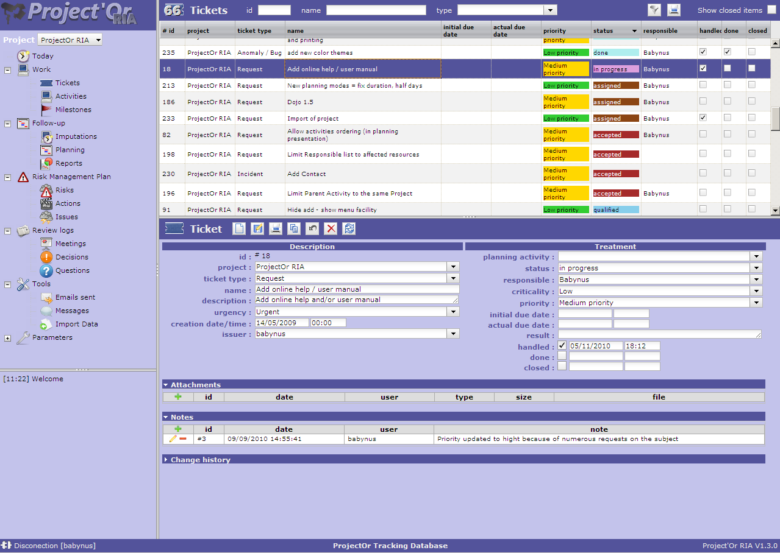
Graphical User Interface (1/6)
Generality
Graphical User Interface is set into several areas.
Some splitters are provided to enable resizing of the parts.
Logo area
Splitter
List area
Menu
area
Splitter
Detail
area
Splitter
Message area
Info bar

Slide 18
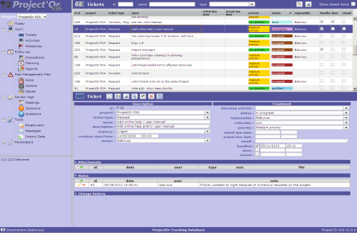

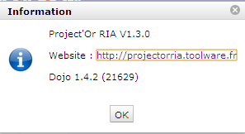

Graphical User Interface (2/6)
Toolbars and else
Clicking on the Logo Area will display the “About” pop-up.
Click on the Help icon will open the online user manual, to the page corresponding to the actual screen, if existing in the manual.
Click on left side of Info bar disconnects user.
Database Name is displayed in the middle of Info bar.
Version of Project’Or RIA is displayed on the right of Info bar. Click here to go web site.
Two buttons provide Show/Hide functionality for menu (left part) and switched mode for list and detail, so that selected element is displayed in “full screen” mode.
When hidden, these areas are replaces by small grey bars. Moving the mouse over the bar displays the initial area.
Message area displays information about main actions : insert, update, delete.
Timestamp indicates when action was done.
This is only a temporary logging area.
Messages displayed here are not stored and will not live more than user connection.

Slide 19
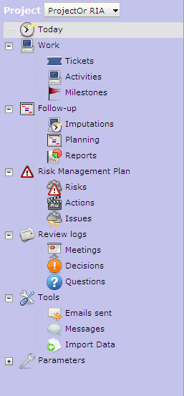
Graphical User Interface (3/6)
Menu
Menu area is proposed as a tree view of reachable items.
The presented items will depend on user habilitation to the screens.
Click on a grouping line will expand-shrink the group.
Click on a item will display the corresponding screen in the main area (right side of the screen).
The Project combo box allows to restrict the visibility of all objects to the dedicated project, including sub-projects if any.
The selection will also define de "default" project for new items.
Example :
  Consider 3 projects P1, P2 and P3, P3 is sub-project of P1.
  Consider 3 tickets T1 on project P1, T2 on project P2, T3 on project P3
  Select "All projects" ⇨ you see the 3 tickets
  Select project P1 ⇨ you see tickets T1 and T3
  Select project P2 ⇨ you see ticket T2
  Create new ticket ⇨ default project is P2
If you create new projects, or change rights so that Projects list appearing in the combo should change, changes will appear only after disconnection/reconnection.

Slide 20
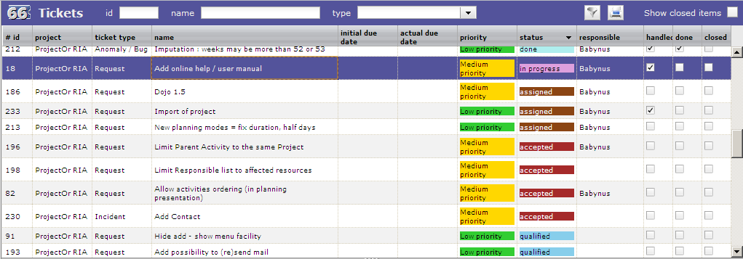
Graphical User Interface (4/6)
List
The main area (right side of the screen) is generally divided in two parts : List area and Detail area.
The upper part lists all the object (for instance, here are tickets).
On top left part, the number of listed items is displayed (here = 66).
Rapid filtering fields are proposed : “id”, “name” and “type” (if significant for the object).
Any change on “id” and “name” will instantly filter data. Search is considered as “contains”, so typing “1” in “id” will select “1”, “10”, “11”, “21”, “31” and so on.
Selecting a “type” in the combo box will restrict the list to the corresponding type (will request server).
Check the “show closed items” to list also closed items.
For more complex filtering, click on the “filter button” (see next page for details).
Click on the “print button” to get a printable version of the list.
Click on the header of a column will sort the list on that column (first ascending, then descending).
The sorting is not always on the displayed name : if the sorted column is linked to a reference list with sort order value, the sorting is executed on this sort value (for instance, here the sorting on the status is executed corresponding to Status sort order value, defined as a logic workflow for status change).
Click on a line (any column) will display the corresponding item in the detail area.

Slide 21
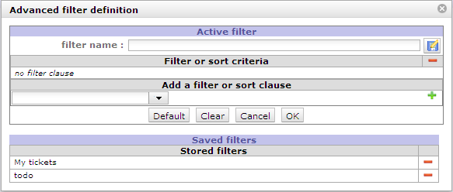
Graphical User Interface (5/6)
Filters
For complex filtering, click on the “filter button” .
The filter pop-up presents two areas : “Active filter” and “Saved filter”.
Enter new clause in Active filter : in “Add a filter or sort clause”, select the name of the field, the operator and the value for the clause. Then click on to add the clause to the filter criteria.
The operator can be “sort” to define a sort criteria, then possible values are “ascending” or “descending”.
Click on on a clause line to remove it.
Click on on the header of Filter criteria to remove all clauses. This can also be done by clicking the “Clear” button.
When Filter criteria is correct, click on “OK” button to apply the filter to the list.
You can also click “Cancel” button to revert to previous filter.
At any step you can enter a filter name and click on to save the filter definition.
Click on a Saved filter to retrieve its definition (filter criteria).
Click on on a saved filter to delete it.
Click on “Default” button to set actual stored filter as default, kept even after disconnection.
When filter is applied, filter button in the list area is checked .
  When filter is a list of values (with “amongst” operator), multi-value selection is possible using [CTRL] key.
  Filters are defined and stored for a user and a type of item (a screen).
  When a filter is applied to a type of item, coming back after moving to another type (another selection in the menu) will apply the previously defined filter.
  After disconnection, currently applied filter is lost, but stored filters are saved. Default filter (if selected) is also stored and will be automatically applied on next connection.

Slide 22
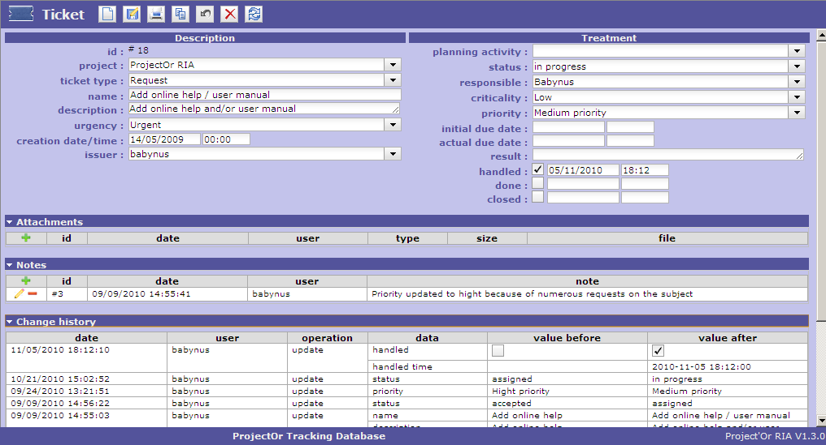
Graphical User Interface (6/6)
Detail
The Detail area present the detail of the selected in the list.
Click on to create new item, to save the changes, to get a printable version of the detail,
to copy the current item, to cancel ongoing changes, to delete the item and to refresh the display.
Some buttons are not clickable when change are ongoing : , , , , .
button is clickable only when changes are ongoing.
On dependant items (for instance “Notes”), click on (in header) to add new, to edit and to delete.
  When changes are ongoing, you can not select another item or another menu item.
  Save or cancel ongoing changes first.

Slide 23
Themes (1/2)
Users can select colors Theme to display the interface.
Just go to Menu "Parameters" ⇨ "Users parameters", and select the new theme in the "theme" select list.
New theme is automatically applied when selected.
Just save parameters to retrieve this theme on each new connection.
Administrator defines on parameters file a default Themes that will be applied on Login screen and up until the users selects a specific theme.
The “random” Theme is not really a Theme, it is a functionality to randomly select a Theme on each new connection.

Slide 24
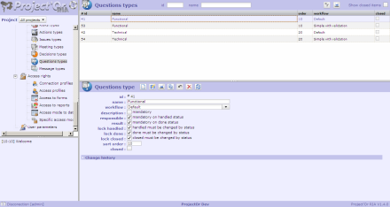
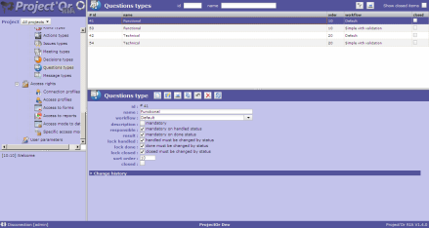
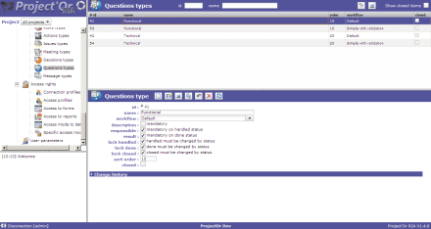
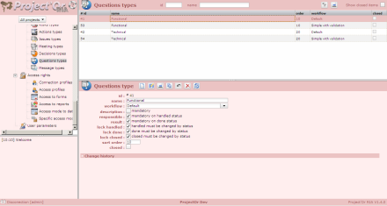
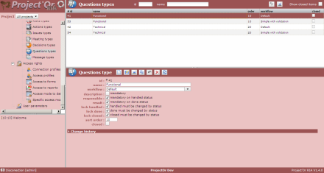
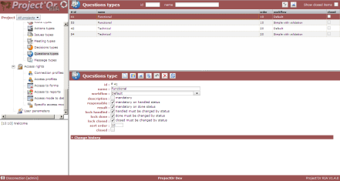
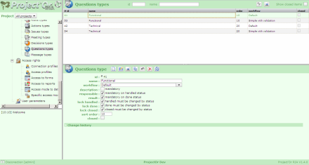
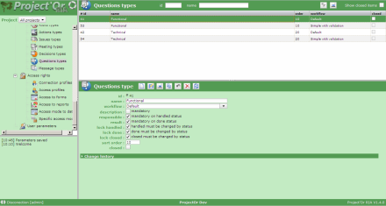
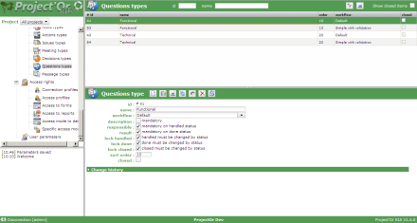
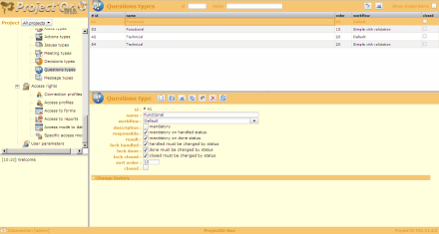
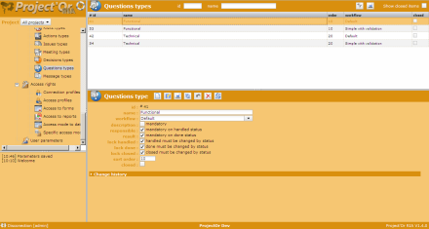
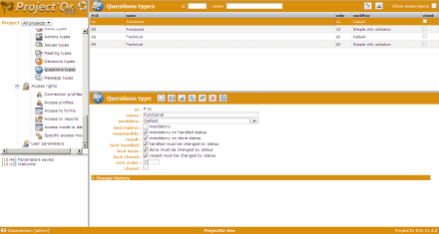
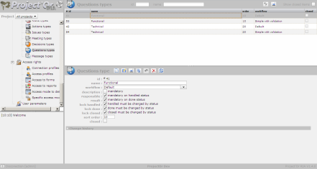
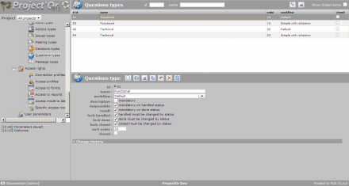
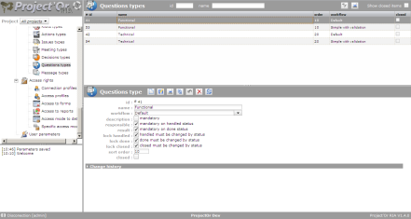
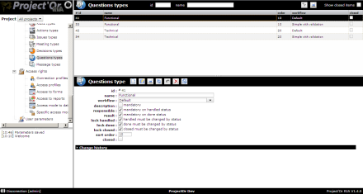
Themes (2/2)
Light
Dark
Contrasted
Blue
Red
Green
Orange
Black & White
Grey

Slide 25
Multilingual
Project’Or RIA is multilingual.
Each user can choose the language to display all the captions.
Of course, data is displayed as input, no translation is operated.
On the login screen, the locale of the browser is used to display captions.
When connected, the language selected (and saved) by the user is used.
When selecting new language, only refreshed data will use new selected language. For instance, all menu items will be kept in the old language. To actualize, save parameters, disconnect and reconnect.
Administrator can define the default language. This one is used on login screen.
It is also used as long as the connected user has not selected his favorite display language.
  All the captions and messages are stored in an Excel file : /tool/i18n/nls/lang.xls.
  To change (or correct) any data, on a windows set-up, open the file to its default place,
  enabling macros.
  “Save-as”, with the same name (to insure the default repository is the default one).
  Click on generate button.
  All the corresponding language files are automatically generated, in /tool.i18n/nsl subfolders.
  To translate to a new language, update one of the existing columns, test using the corresponding locale, and when completed submit the file to support@toolware.fr, to have the new language integrated in the tool.

Slide 26
Creation specificity
  It may sometimes seem that you are not able to attach a file to your new ticket.
  In fact, since a user can update a ticket, he is able to insert an attached file.
  So this is not a question of habilitation.
  The reason is that this functionality do not appear during creation.
  You just have to save first to be able to attach a file.
  This rule is valid for all depending items : Attachments, Notes, Assignments, Predecessor elements, Successor elements and links between Risk, Actions and Issues.
  Just one word : "save" first.
Since V1.3.0, you can rapidly save with [CTRL]+S, like in many office tools.

Slide 27
Update specificity
Since V1.3.0, you can rapidly save with [CTRL]+S, like in many office tools.
When updating an item, only updated fields are stored in the database. This means that if two users are updating different fields of the same item, they don’t crush values updates by each other.

Slide 28
Delete specificity
  After deleting an item, you will not be able to see it any more.
  Data is physically deleted from the database.
  Only the update history can then be access through dedicated reports.
Always consider setting an item to “close” status rather than deleting it. You will then not see it on main screens, but will be able to fetch it, using the “show closed item” checkbox in lists, and possibly re-activate it.
Deleting functionality should be reserve to remove invalid newly created items.
Items with existing dependencies can not be deleted.
Examples :
  You can not delete an activity if a resource is assigned to it.
  You can not delete an assignment is real work has been entered (imputation).
  You can not delete a project with existing items.
  …

Slide 29

Ticket (1/2)
A ticket is a kind of task that can not be unitarily planned.
It is generally a short time activity for a single ticket, that is interesting to follow unitarily to give a feedback to the issuer or to keep trace of result.
It can be globally planned as a general activity, but not unitarily.
For instance, bugs should be managed through tickets :
  you can not plan bugs before they are registered,
  you must be able to give a feedback on each bug,
  you can (or at least should) globally plan bug fixing activity.

Slide 30
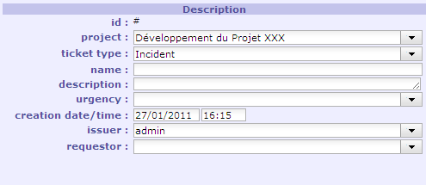
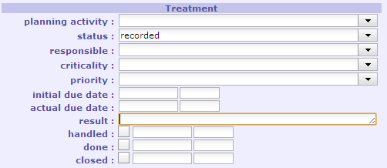
Ticket (2/2)
Fields
Field | Description
Id | Unique Id for the ticket. Automatically generated on creation. Id are shared for all projects and all types of tickets.
Project | The project concerned by the ticket. Mandatory.
Ticket type | Type of ticket.
Name | Short description of the ticket. Mandatory.
Description | Complete description of the ticket. The description can have many lines. The field will auto-extend.
Urgency | Urgency for treatment of the ticket, as requested by the issuer.
Creation date/time | Creation timestamp. Automatically generated on creation. Can be changed.
Issuer | User who created the ticket. Can be changed (for instance if creator is not the issuer).
Requestor | Contact at the origin of the ticket.
Field | Description
Planning Activity | Activity where global wok for this kind of ticket is planned. Work on the ticket will be included on this activity.
Status | Actual status of the ticket. May be linked to a workflow. Change of the status can have several impacts : automatically sending emails, automatically update “Handled”, “Done” or “Closed”, some fields may become mandatory (see related topic) .
Responsible | Resource who is responsible for the treatment of the ticket.
Criticality | Importance of impact on the system, as determined after analysis.
Priority | Priority of treatment. Automatically calculated from Urgency and Criticality. Can be changed manually.
Initial due date | Initial target date for solving the ticket.
Actual due date | Actual target date for solving the ticket. Automatically initialized to Initial due date.
Result | Complete description of the resolution of the ticket. The result can have many lines. The field will auto-extend.
Handled | Flag to indicate that ticket has been taken into account. Timestamp of handling is saved. This generally means that Responsible has been named.
Done | Flag to indicate that ticket has been treated. Timestamp of completion is saved.
Closed | Flag to indicate that ticket is archived. Ticket will not appear in lists any more, unless “show closed” is checked.
Field | Description
Attachments | (see related topic)
Notes | (see related topic)
Change History | (see related topic)

Slide 31

Activity (1/5)
An activity is a kind of task that must be planned, or that regroups other activities.
It is generally a long time activity, that will be assigned to one or more resources.
Activities will appear on Gantt planning view.
For instance, you can manage as activities :
  planned tasks,
  change requests,
  phases,
  versions or releases,
  …
Activities can have parents to regroup activities.
So a WBS (work breakdown structure number) is calculated for the activities.
Activities can be sorted inside their parent activity, on the Gantt planning view, using drag and drop.
Parent activity must belong to the same project.
Resources are can be assigned to activities. This means that some wok is planned on this activity for the resources. Only resources affected to the project of the activity can be assigned to the activity.
Activities can have predecessors and successors, to generate dependencies. Predecessors and successors can be Activities, Milestones or Projects.
If activity A is predecessor of activity B, activity B is automatically successor of activity A.
Predecessors and successors must belong to the same project or be a project.
It is generally advised to split activities so that each unitary one is 1 to 10 days long.
Shorter tasks will lead to unnecessary heavy and complex planning.
Longer tasks will be difficult to follow and estimate in progress : the resources will have difficulties to estimate left work.

Slide 32
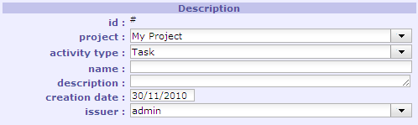
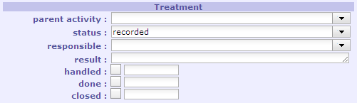
Activity (2/5)
Fields
Field | Description
Id | Unique Id for the activity. Automatically generated on creation. Id are shared for all projects and all types of activities.
Project | The project concerned by the activity. Mandatory.
Activity type | Type of activity.
Name | Short description of the activity. Mandatory.
Description | Complete description of the activity. The description can have many lines. The field will auto-extend.
Creation date | Creation date. Automatically generated on creation. Can be changed.
Issuer | User who created the activity. Can be changed (for instance if creator is not the issuer).
Field | Description
Parent Activity | Parent activity for grouping purpose.
Status | Actual status of the activity. May be linked to a workflow. Change of the status can have several impacts : automatically sending emails, automatically update “Handled”, “Done” or “Closed”, some fields may become mandatory (see related topic) .
Responsible | Resource who is responsible for the treatment of the activity. Responsible must be a resource affected to the project.
Result | Complete description of the treatment done on the activity. The result can have many lines. The field will auto-extend.
Handled | Flag to indicate that activity has been taken into account. Date of handling is saved. This generally means that Responsible has been named.
Done | Flag to indicate that activity has been treated. Date of completion is saved.
Closed | Flag to indicate that activity is archived. Activity will not appear in lists any more, unless “show closed” is checked.
Field | Description
Attachments | (see related topic)
Notes | (see related topic)
Change History | (see related topic)

Slide 33

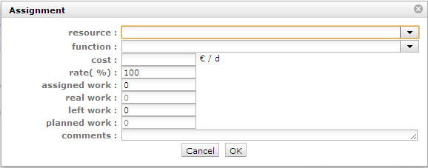
Activity (3/5)
Assignments
Resources can be assigned to activities.
Click on to assign a new resource. An assignment pop up will be displayed.
Click on to modify the assignment.
Click on to delete the assignment. If real work exists for an assignment, it can not be deleted.
It is possible to assign several times the same resource to an activity. It can for instance be used to add extra work without modifying initial assignment.
Field | Description
Resource | Name of the resource assigned to the activity.
Function | The function of the resource on this assignment. This will determine the daily cost of the assignment.
Cost | The daily cost of the assignment. Automatically updated from the function of the resource.
Rate | The max rate (in %) to plan the resource on the activity. For instance, if rate is 50%, the resource will not be planned more than half days on the activity.
Assigned work | Work initially planned to complete the task.
Real work | Real work entered by the resource on his weekly report, on the “real work allocation” screen.
Left work | Work left to complete the task. Calculated as “Assigned Work” – “Real Work”. Must be updated by the resource on the “real work allocation” screen to reflect the really estimated work needed to complete the task.
Planned work | The new total work planned to complete the task. “planned work” = “real work” + “left work”
Comments | Any comment on the affectation. When a comment exists, the icon will appear on the Assignment section, and on the description of the activity on the “real work allocation” screen. Moving the mouse over the description will display the comment.

Slide 34
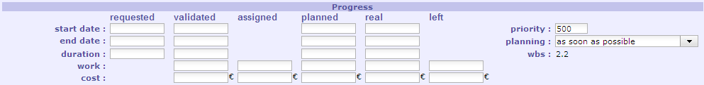
Activity (4/5)
Progress
The progress information will impact Planning calculation, and is also calculated during Planning calculation.
(see related topic)
Field | Description
Requested start date | Wished start date.
Requested end date | Wished end date.
Requested duration | Wished duration.
Validated start date | Committed start date : activity should not start later.
Validated end date | Committed end date : activity should not end later.
Validated duration | Committed duration : activity should not last longer.
Validated work / cost | Committed work / cost : total work / cost of the activity should not be more.
Assigned work / cost | Sum of all the assigned work / cost for the assignments on the activity. Read only.
Planned start date | Calculated start date, taking into account all the constraints (see related topic). Read only.
Planned end date | Calculated end date, taking into account all the constraints (see related topic). Read only.
Planned duration | Calculated duration, taking into account all the constraints (see related topic). Read only. “planned duration” = “planned end date” – “planned start date” (in working days)
Planned work / cost | Calculated total work / cost needed to complete the task. Read only. “planned work” = “real work” + “left work” / “planned cost” = “real cost” + “left cost”
Real start date | Date of the first real work input entered by an resource on the “real work allocation” screen. Read only.
Real end date | If activity is “done”, date of the last real work input entered by an resource on the “real work allocation” screen. Read only.
Real duration | Calculated duration : “real duration” = “real end date” – “real start date” (in working days). Read only.
Real work / cost | Sum of all the work / cost really spent on the activity, entered by resources on the “real work allocation” screen. Read only.
Left work / cost | Left work / cost to complete the activity. Sum of the left work / cost on the assignments on the activity. Read only. Read only.
Priority | Priority of the activity. Smaller priority activities are planned first (see related topic).
Planning | Planning mode for the activity, forcing the way the activity will be planned (see related topic).
Wbs | Work Breakdown Structure. Hierarchical position of the activity in the global planning.
One on the three values is automatically calculated, so that :
“end date” = “start date” + “duration” (in working days)
By default, the duration is calculated (it the three values are entered)
One on the three values is automatically calculated, so that :
“end date” = “start date” + “duration” (in working days)
By default, the duration is calculated (it the three values are entered)

Slide 35
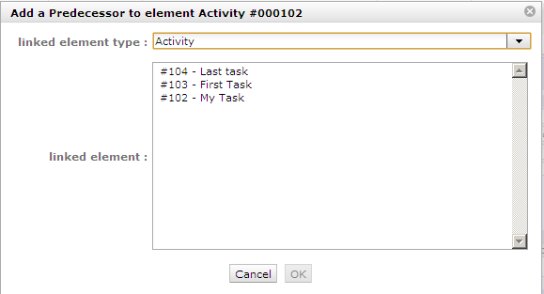
Activity (5/5)
Dependencies
Activities can have predecessors and successors, to generate dependencies.
Predecessors and successors can be Activities, Milestones or Projects.
Click on the corresponding section to add a predecessor or successor.
A “add predecessor” or “add successor” pop up will be displayed.
Select the type of element to add as predecessor or successor.
The list of items below will then be automatically updated.
Select the item in the list and validate (OK).
Recursive loops are controlled on saving.
Click on to delete the corresponding dependency.
If activity A is predecessor of activity B, activity B is automatically successor of activity A.
Field | Description
Type | “Activity”, “Milestone” or “Project”
Id | The id of the predecessor or successor.
Name | Name of the predecessor or successor.
Status | Actual status of the predecessor or successor.
Predecessors and successors must belong to the same project or be a project.
Click on the name of a predecessor or successor will directly move to it.

Slide 36

Milestone (1/4)
A Milestone is a flag in the planning, to point out key dates.
Milestones are commonly used to check delivery dates.
They can also by used to highlight transition from one phase to the following one.
Opposite to Activities, Milestones have no duration and no work.
In Project’Or RIA, two main types of Milestones exist depending on selected Planning Mode :
  floating milestone : the milestone will automatically move to take into account dependencies,
  fixed milestone : the milestone is fixed in the planning, not taking into account predecessor dependencies. This kind of milestone is interesting for instance to set-up start date for some tasks.

Slide 37
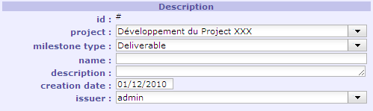
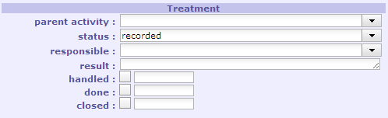
Milestone (2/4)
Fields
Field | Description
Id | Unique Id for the milestone. Automatically generated on creation. Id are shared for all projects and all types of milestones.
Project | The project concerned by the milestone. Mandatory.
Milestone type | Type of milestone.
Name | Short description of the milestone. Mandatory.
Description | Complete description of the milestone. The description can have many lines. The field will auto-extend.
Creation date | Creation date. Automatically generated on creation. Can be changed.
Issuer | User who created the milestone. Can be changed (for instance if creator is not the issuer).
Field | Description
Parent Activity | Parent activity for grouping purpose.
Status | Actual status of the milestone. May be linked to a workflow. Change of the status can have several impacts : automatically sending emails, automatically update “Handled”, “Done” or “Closed”, some fields may become mandatory (see related topic) .
Responsible | Resource who is responsible for the treatment of the milestone.
Result | Complete description of the treatment done on the milestone. The result can have many lines. The field will auto-extend.
Handled | Flag to indicate that milestone has been taken into account. Date of handling is saved. This generally means that Responsible has been named.
Done | Flag to indicate that milestone has been treated. Date of completion is saved.
Closed | Flag to indicate that milestone is archived. Milestone will not appear in lists any more, unless “show closed” is checked.
Field | Description
Attachments | (see related topic)
Notes | (see related topic)
Change History | (see related topic)

Slide 38
Milestone (3/4)
Progress
Field | Description
Requested due date | Wished end date.
Validated due date | Committed end date : milestone should not end later.
Planned due date | Calculated end date, taking into account all the constraints (see related topic). Read only.
Real due date | Real end date, when milestone is set to “done”.
Planning | Planning mode for the milestone , forcing the way the milestone will be planned (see related topic).

Slide 39
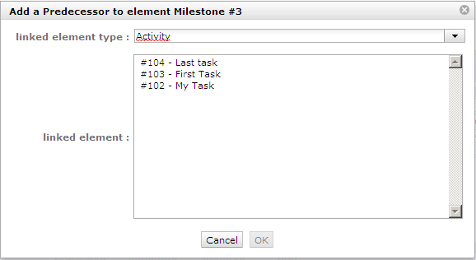
Milestone (4/4)
Dependencies
Milestones can have predecessors and successors, to generate dependencies.
Predecessors and successors can be Activities, Milestones or Projects.
Click on the corresponding section to add a predecessor or successor.
A “add predecessor” or “add successor” pop up will be displayed.
Select the type of element to add as predecessor or successor.
The list of items below will then be automatically updated.
Select the item in the list and validate (OK).
Recursive loops are controlled on saving.
Click on to delete the corresponding dependency.
If activity A is predecessor of activity B, activity B is automatically successor of activity A.
Field | Description
Type | “Activity”, “Milestone” or “Project”
Id | The id of the predecessor or successor.
Name | Name of the predecessor or successor.
Status | Actual status of the predecessor or successor.
Predecessors and successors must belong to the same project or be a project.
Click on the name of a predecessor or successor will directly move to it.

Slide 40

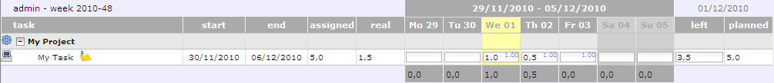
Real work allocation
This screen is devoted to input of real work.
The input is for one resource, on a weekly basis.
Depending on rights management, users call only select themselves as a resource, or select any resource affected to a managed project.
Just changing year and/or week will display the corresponding sheet.
Resource enters work day by day, on each affected activity.
Left work is automatically decreased on input of real work, but it is important that resources think of updating this data to reflect the really estimated left work. This way, planning can be efficient.
The cost corresponding to the work is automatically updated to the assignment, activity and project.
The icon indicates there is a comment on the affectation. Just move the mouse over the activity to see the comment.
One line is displayed for each affectation, displaying the name of the activity.
As it is possible to affect several times the same resource on one activity, it is possible to have several lines for the same activity, with the same name.
Planned work is indicated over each input cell, on top right corner, in light blue color.
This data can be hidden un-checking the corresponding checkbox.

Slide 41

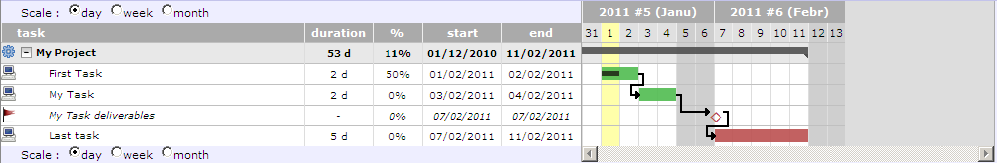
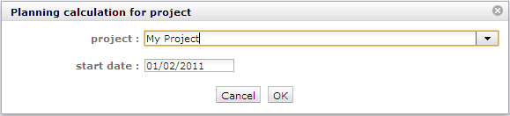
Planning (1/4)
Planning is displayed as a Gantt chart, showing dependencies between tasks.
Overdue tasks appear in red, others in green.
Milestones appear as squares, filled if completed, empty if not.
You can change the scale to have a daily, weekly or monthly view of the chart.
You can select to show tasks’ WBS before the names.
You can change the starting date to display the chart.
To recalculate the planning, click on . Calculation is not automatic.
You then have to select the project to re-calculate, and the start date for the new planning.
  If a resource is assigned to several projects, re-calculation for one will not impact the planning for the others, so new calculation will only use available time slots.
  Use correct resource affectation rate to manage multi-projects affectations.

Slide 42
Planning (2/4)
Planning is calculated “as simply as possible”.
This means that no complex algorithm, with high level mathematic formula, is involved.
The principle is simply to reproduce what you could do on your own, with a simple Excel sheet, but automatically.
Planning is Cross-Project, through affectation rate on the projects.
All the left work is planned, from starting date, to the max date to be able to plan the work.
Calculation is executed task by task, ordering thanks to :
- dependencies (if an activity has a predecessor, the predecessor is calculated first),
- planning mode : regular between dates are planned first
- priority : the smaller values are calculated first
- left work : activities with more less work are planned first
Planning will distribute left work on future days, taking into account several constraints :
A resource has a capacity
Most of the time Capacity = 1 FTE (1 full time equivalent), but it may be more (if the resource is not a person but a team) or less (if the person work only partial time).
A resource is affected to a project, at a certain rate
If resources are not shared between projects, so rate will probably always be 100%.
But if resources are shared, then rate could be less than 100%. If a resource is equally shared between two projects, then each project should enter a rate of 50%. This will lead to control that planning for each project will not overtake rate capacity, so that first project planning its activity will not take all the availability of the resource.
Project affectation capacity is controlled on a weekly basis. This means that planning for a project (including sub-projects) will not be more than (Resource Capacity) x (Resource affectation rate) x 5 for a given week.

Slide 43
Planning (3/4)
A resource is assigned to an activity, at a certain rate
By default, assignment rate is 100%. But it may be less. This means that planning will keep some availability for other tasks.
Assignment capacity is controlled on a daily basis. This means that planning for an activity will not be more than (Resource Capacity) x (Resource assignment rate) for a given day.
An activity has dependencies
An activity will always be planned after its predecessors (and this is recursive).
An activity has a priority and planning mode
Activity with lower priority will be planned first (after taking account of dependencies).
Default priority is 500 (medium).
Possible Planning modes are :
  As soon as possible: Default planning behavior. Task is planned to finish as soon as possible
  As late as possible: Task is planned from end to start.
  Validated end date must be set-up
  Regular between dates: Planning will be equally dispatched from start to end. This mode is best fitted for management activity of recurrent activities not easy to precisely plan.
  Validated start date and Validated end date me be set-up
  Regular in full days: Same as above but planning will try to fill full days activity and not partial activity every day.
  Regular in half days: Same as above but planning will try to fill half days activity.
  Fixed duration: Similar to regular, but with no validated dates. The activity is “floating” depending on predecessors. The duration of this activity will always be kept, even if no work is assigned or left.
A milestone also has a planning mode, possible Planning modes are :
  Floating: milestone will move depending on dependencies
  Fixed: milestone will never move from fixed date

Slide 44
Planning (4/4)
Planning is bases on Progress elements :
  start date,
  end date,
  duration,
  work,
declined on several level:
  requested,
  validated,
  assigned (only for work),
  planned,
  real,
  left (only for work).
“Requested” and “Validated” are “read/write”, as committed elements.
“Assigned work” is directly calculated through assignment to activity (sum of work).
“Planned” data is calculated through planning functionality (and is “read only”).
“Real” data is calculated through imputation data (real work) and “real end date” also depends on status of the activity.
“Left work” is directly what the user input in imputation form.
So, in “Progress” section (of Activity or Project) columns “planned”, “real” and “left” are “read only”.

Slide 45

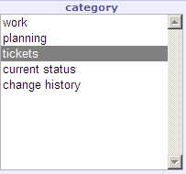
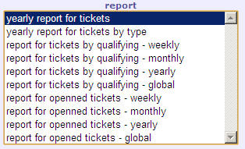
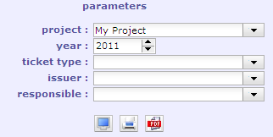
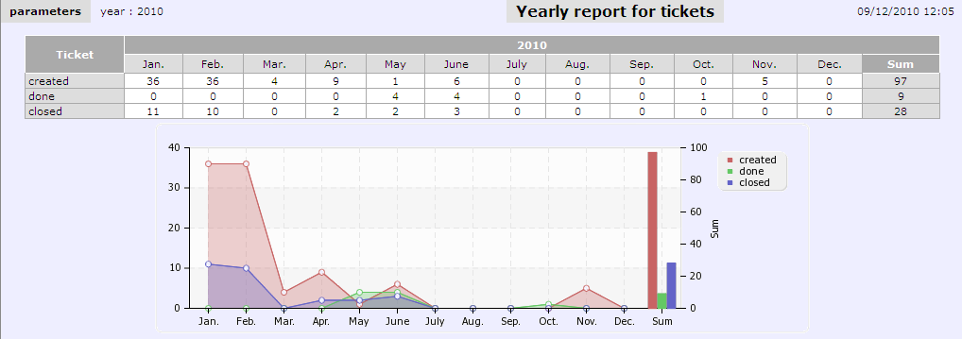
Report
Select the Category of report in the List.
This will update the “report” list
Select the report in the List.
This will display specific parameters for the report.
Update the parameters to get the information you need.
Click on to display the report.
Click on to get a printable version of the report.
Click on to export the report as PDF format.

Slide 46

Risk (1/3)
A risk is any threat of an event that may have a negative impact to the project, and which may be neutralized, or at least minimized, through pre-defined actions.
The risk management plan is a key point to Project Management :
- identify risks and estimate their severity and likelihood.
- identify mitigating actions
- follow-up actions
- identify risks that finally occur (becoming an issue)

Slide 47
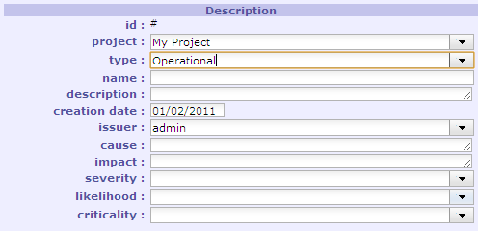
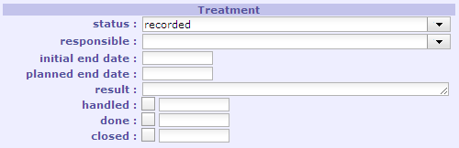
Risk (2/3)
Fields
Field | Description
Status | Actual status of the risk. May be linked to a workflow. Change of the status can have several impacts : automatically sending emails, automatically update “Handled”, “Done” or “Closed”, some fields may become mandatory (see related topic) .
Responsible | Resource who is responsible for the treatment of the risk.
Initial end date | Initially expected end date of the risk.
Planned end date | Updated end date of the risk.
Result | Complete description of the treatment done on the risk. The result can have many lines. The field will auto-extend.
Handled | Flag to indicate that risk has been taken into account. Date of handling is saved. This generally means that Responsible has been named.
Done | Flag to indicate that risk has been treated. Date of completion is saved.
Closed | Flag to indicate that risk is archived. Risk will not appear in lists any more, unless “show closed” is checked.
Field | Description
Id | Unique Id for the risk. Automatically generated on creation. Id are shared for all projects and all types of risks.
Project | The project concerned by the risk. Mandatory.
Risk type | Type of risk.
Name | Short description of the risk. Mandatory.
Description | Complete description of the risk. The description can have many lines. The field will auto-extend.
Creation date | Creation date. Automatically generated on creation. Can be changed.
Issuer | User who created the risk. Can be changed (for instance if creator is not the issuer).
Cause | Description of the event that may trigger the risk.
Impact | Description of the estimated impact on the project if the risk occurs.
Severity | Level of importance of the impact for the project.
Likelihood | Probability level of the risk to occur.
Criticality | Global evaluation level of the risk. Automatically calculated from Severity and Likelihood values. Can be changed
Field | Description
Attachments | (see related topic)
Notes | (see related topic)
Change History | (see related topic)

Slide 48
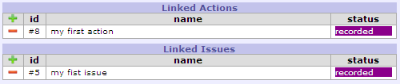
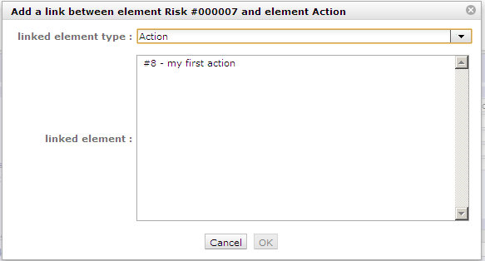
Risk (3/3)
Dependencies
Field | Description
Id | Id of the linked element.
Name | Name of the linked element.
Status | Actual status of the linked element.
Risks can be linked to actions :
- risk mitigation actions
- impact mitigation actions
Risks can be linked to issues :
- when a risk occurs it becomes an issue
Click on the corresponding section to add a link to an action or an issue.
A “add link” pop up will be displayed.
Select the linked element in the list and validate (OK).
Click on to delete the corresponding link.
If Risk R is linked to Action A and issue I, Issue I and Action A are automatically linked to Risk R.
Linked actions and issues must belong to the same project.
Click on the name of an action or of an issue will directly move to it.

Slide 49

Action (1/3)
An action is a task or activity that is set-up in order to :
- reduce the likelihood of a risk
- reduce the impact of a risk
- solve an issue
The actions are the main activities of the risk management plan.
They must be regularly followed-up.

Slide 50
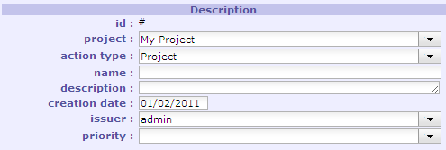
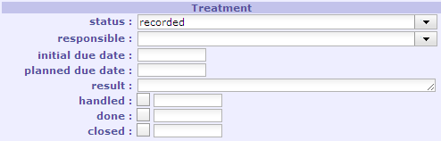
Action (2/3)
Fields
Field | Description
Id | Unique Id for the action. Automatically generated on creation. Id are shared for all projects and all types of actions.
Project | The project concerned by the action. Mandatory.
action type | Type of action.
Name | Short description of the action. Mandatory.
Description | Complete description of the action. The description can have many lines. The field will auto-extend.
Creation date | Creation date. Automatically generated on creation. Can be changed.
Issuer | User who created the action. Can be changed (for instance if creator is not the issuer).
Priority | Priority requested to the treatment of the action.
Field | Description
Status | Actual status of the action. May be linked to a workflow. Change of the status can have several impacts : automatically sending emails, automatically update “Handled”, “Done” or “Closed”, some fields may become mandatory (see related topic) .
Responsible | Resource who is responsible for the treatment of the action.
Initial due date | Initially expected end date of the action.
Planned due date | Updated end date of the action.
Result | Complete description of the treatment of the action. The result can have many lines. The field will auto-extend.
Handled | Flag to indicate that action has been taken into account. Date of handling is saved. This generally means that Responsible has been named.
Done | Flag to indicate that action has been treated. Date of completion is saved.
Closed | Flag to indicate that action is archived. Action will not appear in lists any more, unless “show closed” is checked.
Field | Description
Attachments | (see related topic)
Notes | (see related topic)
Change History | (see related topic)

Slide 51
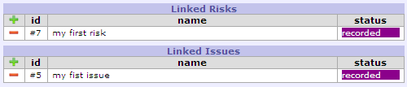
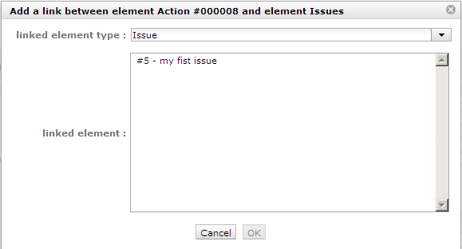
Action (3/3)
Dependencies
Field | Description
Id | Id of the linked element.
Name | Name of the linked element.
Status | Actual status of the linked element.
Actions can be linked to risks :
- risk mitigation actions
- impact mitigation actions
Actions can be linked to issues :
- when a risk occurs it becomes an issue
Click on the corresponding section to add a link to a risk or an issue.
A “add link” pop up will be displayed.
Select the linked element in the list and validate (OK).
Click on to delete the corresponding link.
If Action A is linked to Risk R and Issue I, Issue I and Risk R are automatically linked to Action A.
Linked risks and issues must belong to the same project.
Click on the name of a risk or of an issue will directly move to it.

Slide 52

Issue (1/3)
An issue is a problem that occurs during the project.
If the Risk Management Plan has been correctly managed, issues should always be occurring identified Risks.
Action must be defined to solve the issue.

Slide 53
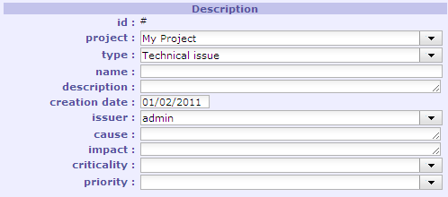
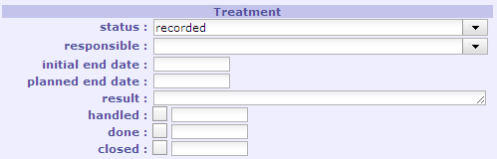
Issue (2/3)
Fields
Field | Description
Status | Actual status of the issue. May be linked to a workflow. Change of the status can have several impacts : automatically sending emails, automatically update “Handled”, “Done” or “Closed”, some fields may become mandatory (see related topic) .
Responsible | Resource who is responsible for the treatment of the issue.
Initial end date | Initially expected end date of the issue.
Planned end date | Updated end date of the issue.
Result | Complete description of the treatment of the issue. The result can have many lines. The field will auto-extend.
Handled | Flag to indicate that issue has been taken into account. Date of handling is saved. This generally means that Responsible has been named.
Done | Flag to indicate that issue has been treated. Date of completion is saved.
Closed | Flag to indicate that issue is archived. Issue will not appear in lists any more, unless “show closed” is checked.
Field | Description
Id | Unique Id for the issue. Automatically generated on creation. Id are shared for all projects and all types of issues.
Project | The project concerned by the issue. Mandatory.
Issue type | Type of issue.
Name | Short description of the issue. Mandatory.
Description | Complete description of the issue. The description can have many lines. The field will auto-extend.
Creation date | Creation date. Automatically generated on creation. Can be changed.
Issuer | User who created the issue. Can be changed (for instance if creator is not the issuer).
Cause | Description of the event that led to the issue.
Impact | Description of the impact of the issue on the project.
Criticality | Level of importance of the impact for the project.
Priority | Priority requested to the treatment of the issue.
Field | Description
Attachments | (see related topic)
Notes | (see related topic)
Change History | (see related topic)

Slide 54


Issue (3/3)
Dependencies
Field | Description
Id | Id of the linked element.
Name | Name of the linked element.
Status | Actual status of the linked element.
Issues can be linked to risks :
- When a risk occurs, it becomes an issue
Issues can be linked to actions :
- impact mitigation actions
- resolution action
Click on the corresponding section to add a link to a risk or an action.
A “add link” pop up will be displayed.
Select the linked element in the list and validate (OK).
Click on to delete the corresponding link.
If Issue I is linked to Risk R and Action A, Action A and Risk R are automatically linked to Issue I.
Linked risks and actions must belong to the same project.
Click on the name of a risk or of an action will directly move to it.

Slide 55

Meeting (1/3)
Meeting items are stored to keep trace of important meetings during the project lifecycle :
  Progress Meetings
  Steering committees
  Functional workshops
  …
In fact, you should keep trace of every meeting where decisions are taken, or questions answered.
This will provide an easy way to find back when, where and why a decision has been taken.

Slide 56


Meeting (2/3)
Fields
Field | Description
Id | Unique Id for the meeting. Automatically generated on creation. Id are shared for all projects and all types of meetings.
Project | The project concerned by the meeting. Mandatory.
Meeting type | Type of meeting.
Meeting date | Date of the meeting (initially expected date).
Attendees | List of persons attending (or expecting to attend) the meeting.
Field | Description
Status | Actual status of the meeting. May be linked to a workflow. Change of the status can have several impacts : automatically sending emails, automatically update “Handled”, “Done” or “Closed”, some fields may become mandatory (see related topic) .
Responsible | Resource who is responsible for the organization of the meeting.
Minutes | Minutes of the meeting. You can enter here only a short summary of the minutes and attach the full minutes as a file.
Handled | Flag to indicate that meeting has been taken into account. Date of handling is saved. This generally means that Responsible has been named.
Done | Flag to indicate that meeting has been held. Date of meeting is saved.
Closed | Flag to indicate that meeting is archived. Meeting will not appear in lists any more, unless “show closed” is checked.
Field | Description
Attachments | You may attach Minutes file here. (see related topic)
Notes | (see related topic)
Change History | (see related topic)

Slide 57


Meeting (3/3)
Dependencies
Field | Description
Id | Id of the linked element.
Name | Name of the linked element.
Status | Actual status of the linked element.
Meetings can be linked to decisions :
- Decisions taken during the meeting
Meetings can be linked to questions :
- Questions raised during the meeting
- Questions answered during the meeting
Click on the corresponding section to add a link to a decision or a question.
A “add link” pop up will be displayed.
Select the linked element in the list and validate (OK).
Click on to delete the corresponding link.
If Meeting M is linked to Question Q and Decision D, Decision D and Question Q are automatically linked to Meeting M.
Linked Decisions and Quesitons must belong to the same project.
Click on the name of a Decision or of a Question will directly move to it.

Slide 58

Decision (1/3)
Decisions are stored to keep trace of important decisions, when, where and why the decision was taken.
You can link a decision to a meeting to rapidly find the minutes where the decision is described.

Slide 59


Decision (2/3)
Fields
Field | Description
Id | Unique Id for the decision. Automatically generated on creation. Id are shared for all projects and all types of decisions.
Project | The project concerned by the decision. Mandatory.
Decision type | Type of decision.
Name | Short description of the decision. Mandatory.
Description | Complete description of the decision. The description can have many lines. The field will auto-extend.
Field | Description
Status | Actual status of the decision. May be linked to a workflow. Change of the status can have several impacts : automatically sending emails, automatically update “Handled”, “Done” or “Closed”, some fields may become mandatory (see related topic) .
Decision date | Date of the decision
Origin | Origin of the decision. It can be either the reference to a meeting where decision was taken (so also add the reference to the meetings list), or a short description of why the decision was taken.
Accountable | Resource accountable for the decision. (the person who took the decision)
Closed | Flag to indicate that decision is archived. Decision will not appear in lists any more, unless “show closed” is checked.
Field | Description
Attachments | (see related topic)
Notes | (see related topic)
Change History | (see related topic)

Slide 60


Decision (3/3)
Dependencies
Field | Description
Id | Id of the linked element.
Name | Name of the linked element.
Status | Actual status of the linked element.
Decisions can be linked to meetings :
- Meeting during which decision was taken
Click on the corresponding section to add a link to a meeting.
A “add link” pop up will be displayed.
Select the linked element in the list and validate (OK).
Click on to delete the corresponding link.
If Decision D is linked to Meeting M, Meeting M is automatically linked to Decision D.
Linked Meetings must belong to the same project.
Click on the name of a Meeting will directly move to it.

Slide 61

Question (1/3)
Question are stored to keep trace of important Questions and Answers.
In fact, you should keep trace of every question and answer that have an impact to the project.
The Questions can also afford an easy way to track questions sent and follow-up non-answered ones.
This will provide an easy way to find back when, who and precise description of the answer to a question.
Also keep in mind that some people will (consciously or not) be able to change their mind and uphold it has always been their opinion…
You can link a question to a meeting to rapidly find the minutes where the question was raised or answered.

Slide 62


Question (2/3)
Fields
Field | Description
Id | Unique Id for the question. Automatically generated on creation. Id are shared for all projects and all types of questions.
Project | The project concerned by the question. Mandatory.
Question type | Type of question.
Name | Short description of the question. Mandatory.
Description | Complete description of the question. The description can have many lines. The field will auto-extend.
Creation date | Creation date. Automatically generated on creation. Can be changed.
Issuer | User who created the question. Can be changed (for instance if creator is not the issuer).
Field | Description
Status | Actual status of the question. May be linked to a workflow. Change of the status can have several impacts : automatically sending emails, automatically update “Handled”, “Done” or “Closed”, some fields may become mandatory (see related topic) .
Responsible | Resource who is responsible for the follow-up of the question.
Initial due date | Initially expected date for the answer to the question.
Planned due date | Updated expected date for the answer to the question.
Response | Complete description of the answer to the question. The response can have many lines. The field will auto-extend.
Replier | Name of the person who provided the answer.
Handled | Flag to indicate that question has been taken into account. Date of handling is saved. This generally means that Responsible has been named.
Done | Flag to indicate that question has been answered. Date of answer is saved.
Closed | Flag to indicate that question is archived. Question will not appear in lists any more, unless “show closed” is checked.
Field | Description
Attachments | (see related topic)
Notes | (see related topic)
Change History | (see related topic)

Slide 63

Question (3/3)
Dependencies
Field | Description
Id | Id of the linked element.
Name | Name of the linked element.
Status | Actual status of the linked element.
Questions can be linked to meetings :
- Meeting during which question was raised or answered
Click on the corresponding section to add a link to a meeting.
A “add link” pop up will be displayed.
Select the linked element in the list and validate (OK).
Click on to delete the corresponding link.
If Question Q is linked to Meeting M, Meeting M is automatically linked to Question Q.
Linked Meetings must belong to the same project.
Click on the name of a Meeting will directly move to it.

Slide 64


Emails
You can have a look at the list of the automatic emails sent (see related topic).
You will have all the information about the email, including the status showing whether the email was correctly sent or not.
The information in the screen is read-only.

Slide 65


Message
You can define some message that we be displayed on the “today” screen of users.
You can limit the display to some profile and/or project and/or user.
The message will be displayed in a color depending on the Message type
Field | Description
Id | Unique Id for the message. Automatically generated on creation. Id are shared for all projects and all types of message.
Title | Header of the message. Mandatory.
Message type | Type of message.
Description | Complete text of the message. The description can have many lines. The field will auto-extend.
Profile | The profile of users who will see the message.
Project | The project to limit display. Only resources affected to the project will see the message
User | User who will see the message. Useful to send a message to one only user. As user is more restrictive than Profile and/or Project, you should not select these ones when selecting user.
Closed | A status to stop showing the message. You then don’t have to delete it, for instance to be able to show it again later…

Slide 66

Import
Imports work from CSV files (and only CSV files on actual version).
The first line of the file must contain de name of the fields : look into the Model class : the names are the same. Just click on specific help button to have help on fields.
You may or may not add an "id" column to the file :
- if column "id" exists and "id" is set for a line, the import will try to update the corresponding element, and will fail if it does not exist
- if column "id" does not exists or if "id" is not set for a line, the import will create a new element from the data.
In any case, columns with no data will not be updated : then you can update only one field on an element.
To clear a data, enter the value "NULL" (not case sensitive).
For columns corresponding to linked tables ("idXxxx"), you can indicate as the column name :
- either "idXxxx" : the code of the element in the linked table is expected
- either "Xxxx" (without "id") : the name of the element in the linked table is then expected, bringing better readability to the file.
Names of columns can contain spaces (to have better readability) : the spaces will be removed to get the name of the column.
Dates are expected in format “YYYY-MM-DD”.
Insertion into "Planning" elements (activity, project), automatically inserts an element in the table “PlanningElement” : the data of this table can be inserted into the import file (working from version V1.3.0).

Slide 67



Customer
The Customer is the entity for which the Project is set.
It is generally the owner of the project, and in many cases it is the payer.
It can be an internal entity, into the same enterprise, or a different enterprise, or the entity of an enterprise.
The customer defined here is not a person. Real persons into customer entity are called “Contacts”.
Field | Description
Id | Unique Id for the customer. Automatically generated on creation.
Customer name | Short name of the customer. Mandatory.
Description | Complete description of the customer. The description can have many lines. The field will auto-extend.
Customer code | Code of the customer. Informative data.
Closed | Flag to indicate that customer is archived. Customer will not appear in lists any more, unless “show closed” is checked.
Field | Description
Projects | List of the projects of the customer
Contacts | List of the contacts known in the entity of the customer.

Slide 68


Contact
The Contact is a person into the organization of the customer.
The requestor of a ticket must be a contact.
It can be interesting to define all the informative data of the contact to be able to contact him when needed.
Field | Description
Id | Unique Id for the contact. Automatically generated on creation.
Name | Name of the contact. Can contain first and last name. This information will be displayed in lists.
Description | Complete description of the contact. The description can have many lines. The field will auto-extend.
Customer | The Customer the contact belongs to (the contact is a person into the organization of the customer).
Is a user | Is this contact a also a user ? Check this if the contact must connect to the application. You must then define the user name, that can be the same as the contact name or not, and the profile. The contact will then also appear in the “Users” list.
Profile | Profile of the user (see related topic)
User name | User name. Same as name is user form (see related topic) Mandatory if “Is a user” is checked.
Email address | Email address of the contact. Automatic emailing will use this address.
Address | Address of the contact. Informative data.
Phone | Phone number of the contact. Informative data.
Mobile | Mobile phone number of the contact. Informative data.
Fax | Fax number of the contact. Informative data.
Closed | Flag to indicate that contact is archived. Contact will not appear in lists any more, unless “show closed” is checked.

Slide 69

Project (1/4)
Project is the main entity of Project’Or RIA.
It is also the top level of visibility, depending on profiles.
You can define some profiles, some will have visibility to all projects, others only to projects they are affected to.
You can also define sub-projects of a project.
This splitting can be functional :
(for instance to split several versions)
or organizational :
(for instance to manage access rights)
Project X
⇨ Project X
⇨ Project X V1
⇨ Project X V2
⇨ Project X V3
Project X
V1
Project X
V2
Project X
V3
Project X
⇨ Project X
⇨ Project X V1 Maint.
⇨ Project X V1 Evo.
⇨ Project X V1 Bug.
⇨ Project X V2 Dev.
Project X
V1
Maintenance
Project X
V2
Development
Project X
V1
Evolutions
Project X
V1
Bug Fixing
Project X V1 can be shared with a large scope of users, while others will be restricted to internal team.

Slide 70


Project (2/4)
Fields
Field | Description
Sub projects | List of the sub-projects of the current project.
Resources | List of the resources affected to the project, showing affectation rate to the project (see related topic).
Field | Description
Id | Unique Id for the project. Automatically generated on creation.
Name | Short name of the project. Mandatory.
Description | Complete description of the project. The description can have many lines. The field will auto-extend.
Customer | The customer of the project (see related topic)
Project code | Code of the project. Informative data.
Contract code | Code of the contract of the project. Several projects may share the save contract code. Informative data.
Is sub-project of | Name of the top project if this project is a sub-project.
Manager | Name of the resource who manages the project (Project Leader).
Color | Color of the project, to be displayed in some repots.
Done | Flag to indicate that project is been finished. Date of end is saved.
Closed | Flag to indicate that project is archived. Project will not appear in lists any more, unless “show closed” is checked.
Field | Description
Change History | (see related topic)

Slide 71

Project (3/4)
Progress
The progress information will impact Planning calculation, and is also calculated during Planning calculation.
(see related topic)
Field | Description
Requested start date | Wished start date.
Requested end date | Wished end date.
Requested duration | Wished duration.
Validated start date | Committed start date : project should not start later.
Validated end date | Committed end date : project should not end later.
Validated duration | Committed duration : project should not last longer.
Validated work / cost | Committed work / cost : total work / cost of the project should not be more.
Assigned work / cost | Sum of all the assigned work / cost for the assignments on the project. Read only.
Planned start date | Calculated start date, taking into account all the constraints (see related topic). Read only.
Planned end date | Calculated end date, taking into account all the constraints (see related topic). Read only.
Planned duration | Calculated duration, taking into account all the constraints (see related topic). Read only. “planned duration” = “planned end date” – “planned start date” (in working days)
Planned work / cost | Calculated total work / cost needed to complete the task. Read only. “planned work” = “real work” + “left work” / “planned cost” = “real cost” + “left cost”
Real start date | Date of the first real work input entered by an resource on the “real work allocation” screen. Read only.
Real end date | If project is “done”, date of the last real work input entered by an resource on the “real work allocation” screen. Read only.
Real duration | Calculated duration : “real duration” = “real end date” – “real start date” (in working days). Read only.
Real work / cost | Sum of all the work / cost really spent on the project , entered by resources on the “real work allocation” screen. Read only.
Left work / cost | Left work / cost to complete the project . Sum of the left work / cost on the activities of the project. Read only. Read only.
Wbs | Work Breakdown Structure. Hierarchical position of the project in the global planning.
One on the three values is automatically calculated, so that :
“end date” = “start date” + “duration” (in working days)
By default, the duration is calculated (it the three values are entered)
One on the three values is automatically calculated, so that :
“end date” = “start date” + “duration” (in working days)
By default, the duration is calculated (it the three values are entered)

Slide 72

Project (4/4)
Dependencies
Projects can have predecessors and successors, to generate dependencies.
Predecessors and successors can be Activities, Milestones or Projects.
Click on the corresponding section to add a predecessor or successor.
A “add predecessor” or “add successor” pop-up will be displayed.
Select the type of element to add as predecessor or successor.
The list of items below will then be automatically updated.
Select the item in the list and validate (OK).
Recursive loops are controlled on saving.
Click on to delete the corresponding dependency.
If Project A is predecessor of Project B, Project B is automatically successor of Project A.
Field | Description
Type | “Activity”, “Milestone” or “Project”
Id | The id of the predecessor or successor.
Name | Name of the predecessor or successor.
Status | Actual status of the predecessor or successor.
Pay attention to the heavy constraints that adding a predecessor will bring to the project. You should for instance restrict this use to link sub-projects of a main project.
Click on the name of a predecessor or successor will directly move to it.

Slide 73
User
To be completed

Slide 74
Team
To be completed

Slide 75
Resource
To be completed

Slide 76
Affectation
To be completed

Slide 77
Function
To be completed

Slide 78
Status
To be completed

Slide 79
Severity
To be completed

Slide 80
Likelihood
To be completed

Slide 81
Criticality
To be completed

Slide 82
Urgency
To be completed

Slide 83
Priority
To be completed

Slide 84
Workflow
To be completed

Slide 85
Automatic emailing
You changed the status of a ticket and the tool replied "Item updated – email sent".
But what contained that email ? And why did you not receive this email ?
Just go to Menu "Tools" => "Sent emails" to see the content of the email !
You’ll see who was addressee of the email.
If you’re not in the list, just check with you’re admin, it’s a question of email parameters.
But this is another story…
Basically, you should at least see the emails you've sent.
But you can also have visibility on all your project's emails or all the email.
This can be done by the admin, who can parameter email visibility.
Sure he will reserve to himself the last option (see all the emails).
To be completed

Slide 86
Ticket type
To be completed

Slide 87
Activity type
To be completed

Slide 88
Milestone type
To be completed

Slide 89
Risk type
To be completed

Slide 90
Action type
To be completed

Slide 91
Issue type
To be completed

Slide 92
Meeting type
To be completed

Slide 93
Decision type
To be completed

Slide 94
Question type
To be completed

Slide 95
Message type
To be completed

Slide 96
Profile
To be completed

Slide 97
Access mode
To be completed

Slide 98
Access to forms
To be completed

Slide 99
Access to reports
To be completed

Slide 100
Access mode to data
To be completed

Slide 101
Specific access mode
To be completed

Slide 102
User parameters
To be completed

Slide 103

Attachments
Users can attach files on most of items.
To attach a file, just click on the icon.
An attachment pop-up will appear :
An attachment can not be modified.
It can only be deleted with icon.
Only the user who created the attachment can delete it.
Click on icon to download the attached file.
Field | Description
Id | Unique Id for the attachment. Automatically generated on creation. Id are shared for all projects and all attachments.
Date | Date of creation of the attachment.
User | Name of the user who attached the file.
Type | Mime type of the file.
Size | Size of the file.
File | File name.
Description | A comment to describe the file. If description is entered, the note icon will appear on file column, and moving the mouse over the file name will display the description.
Attached files are stored on server side, on a place specified by the administrator on parameters.
Attachment section can be folded or unfolded, clicking on the section title.
Each user can change on user parameters the default display of the section (folded or not).

Slide 104

Notes
Users can add notes on most items.
Notes are comments, that can be shared to
track some information or progress.
To add a note, just click on the icon.
A note pop-up will appear :
A note can be modified with the icon.
This will display the note pop-up for editing the note.
A note can be deleted with icon.
Only the user who created the note can modify or delete it.
Field | Description
Id | Unique Id for the note. Automatically generated on creation. Id are shared for all projects and all notes.
Date | Date of creation or modification of the attachment. Creation date is displayed straight. Last modification date is displayed in italic.
User | Name of the user who created the note.
Type | Mime type of the file.
Note | Text of the note.
Note section can be folded or unfolded, clicking on the section title.
Each user can change on user parameters the default display of the section (folded or not).

Slide 105

Change History
All the changes items are tracked.
They are stored and displayed on each item.
On creation, just an insert operation is stored,
not all the initial values on creation.
Field | Description
Date | Date of change operation.
User | Name of the user who operated the change.
Operation | The operation on the item (insert or update)
Data | The field modified.
Value before | The value of the field before the update.
Value after | The value of the field after the update.
Change history section can be folded or unfolded, clicking on the section title.
Each user can change on user parameters the default display of the section (folded or not) or even select to hide this section.

Slide 106



Today
The “Today” screen is the first to be displayed on each connection.
It is divided in 3 parts. Each part can be folded/unfolded with a click on the header.
Messages :
Here are displayed the messages defined in the “message” section.
Projects :
A quick overview of the projects status. The projects list is limited to project visibility scope of the connected user.
Progress display is based on work. Counted items can be the “to do” (not done), “not closed” (to do and done) or “all” (to do, done and closed). “to do”, “done” and “closed” status are based on corresponding checkboxes.
A progress bar on each item shows part of “to do” (red) compared to “done and closed” (green).
On mouse over the bar, detail of figures is displayed.
[CTRL]+S
Work :
Here is a “todo list”. Here are listed all the items for which the connected user is either the issuer or the responsible or assigned to (if the user is also a resource). Click on the name of an item will directly move to it.

Slide 107
Backup / Restore
Backup is a good practice.
You should regularly backup your Data to be able to retrieve it is case of a crash.
How often ?
It just depends on your need ...
Just ask yourself : what is acceptable to loose in case of a crash ? 1 day, 1 week ?
You should also always backup your Data before any application upgrade... in case of ...
So, how to back-up ?
The simplest way is to use phpMyAdmin export capacity, using "SQL" format, saving result to a file.
Then you'll be able to import Data from this exported file.
Hints :
  be sure to use UTF-8 charset when exporting / importing
  you cannot import into a full Database (with existing Data) :
    either you truncate the tables before import
    (you must then assure to import Data into a structure of the same version of application !)
    you drop the tables before import
    you export data including 'Drop tables‘
  regularly test your back-up files, trying to restore it on an empty Database
  (so many times backup are never tested, and can not be imported when needed...)
[CTRL]+S

Slide 108
Shortcuts
Shortcut keys | Effect
[CTRL]+s | Save the current item
[F1] | Open manual, on dedicated contextual topic (if exists)
[CTRL]+S

Slide 109
Last words
Hofstader's Law
  "It always takes longer than you expect, even if you take Hofstadter's Law into account"
Murphy's Law
  "Whatever can go wrong will go wrong"
  "... and at the worst possible time, in the worst possible way."
This simply means that whatever your planning is, it is wrong !
So, you’d better manage risks and follow-up all the events on your project…
Change History of Project’Or RIA can be found on the web site:
You can also access to the track Database (running as a Project’Or RIA instance) to see details of changes as tickets.
http://projectorria.toolware.fr
Current version of Manual : V0.6
Based on Project’Or RIA : V1.5.1

